Slide 1
Genetic Algorithm for Variable Selection
Jennifer Pittman
ISDS
Duke University

Slide 2
Genetic Algorithms
Step by Step
Jennifer Pittman
ISDS
Duke University

Slide 3
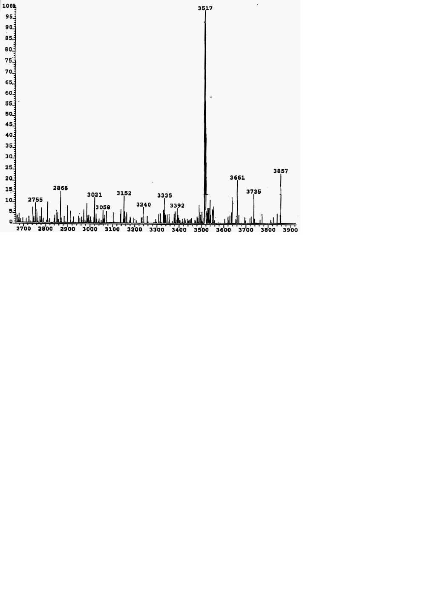
Example: Protein Signature Selection in Mass Spectrometry
relative intensity
http://www.uni-mainz.de/~frosc000/fbg_po3.html
molecular weight
Notes:
Select peptides then correlate to known proteins

Slide 4
Genetic Algorithm (Holland)
heuristic method based on ‘ survival of the fittest ’
useful when search space very large or too complex
for analytic treatment
in each iteration (generation) possible solutions or
individuals represented as strings of numbers
3021 3058 3240
00010101 00111010 11110000
00010001 00111011 10100101
00100100 10111001 01111000
11000101 01011000 01101010

Slide 5
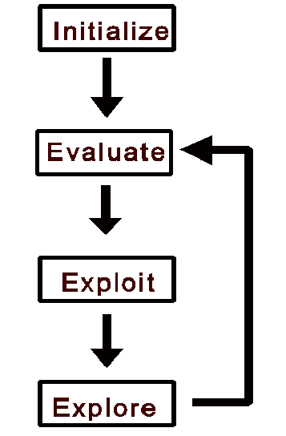
© http://www.spectroscopynow.com
all individuals in population
evaluated by fitness function
individuals allowed to
reproduce (selection),
crossover, mutate
Flowchart of GA
Notes:
Flowchart of GA iteration

Slide 6
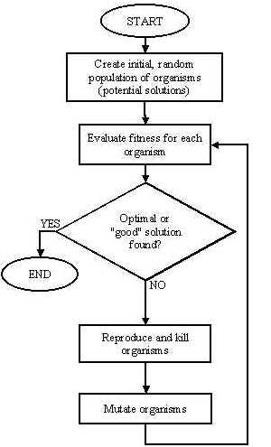
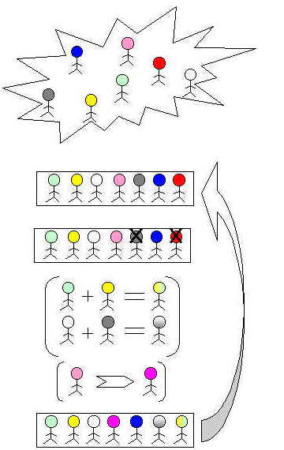
http://ib-poland.virtualave.net/ee/genetic1/3geneticalgorithms.htm

Slide 7
(a simplified example)
Initialization
proteins corresponding to 256 mass spectrometry
values from 3000-3255 m/z
assume optimal signature contains 3 peptides
represented by their m/z values in binary encoding
population size ~M=L/2 where L is signature length
Notes:
Mass/charge
Phenotype (actual ind) vs genotype

Slide 8
00010101 00111010 11110000
Initial Population
00010101 00111010 11110000
00010001 00111011 10100101
00100100 10111001 01111000
M = 12
11000101 01011000 01101010
L = 24
Notes:
Phenotype to genotype

Slide 9
Searching
search space defined by all possible encodings of
solutions
selection, crossover, and mutation perform
‘pseudo-random’ walk through search space
operations are non-deterministic yet directed
Notes:
Non-deterministic since random crossover point or mutation prob. Directed by fitness fn

Slide 10
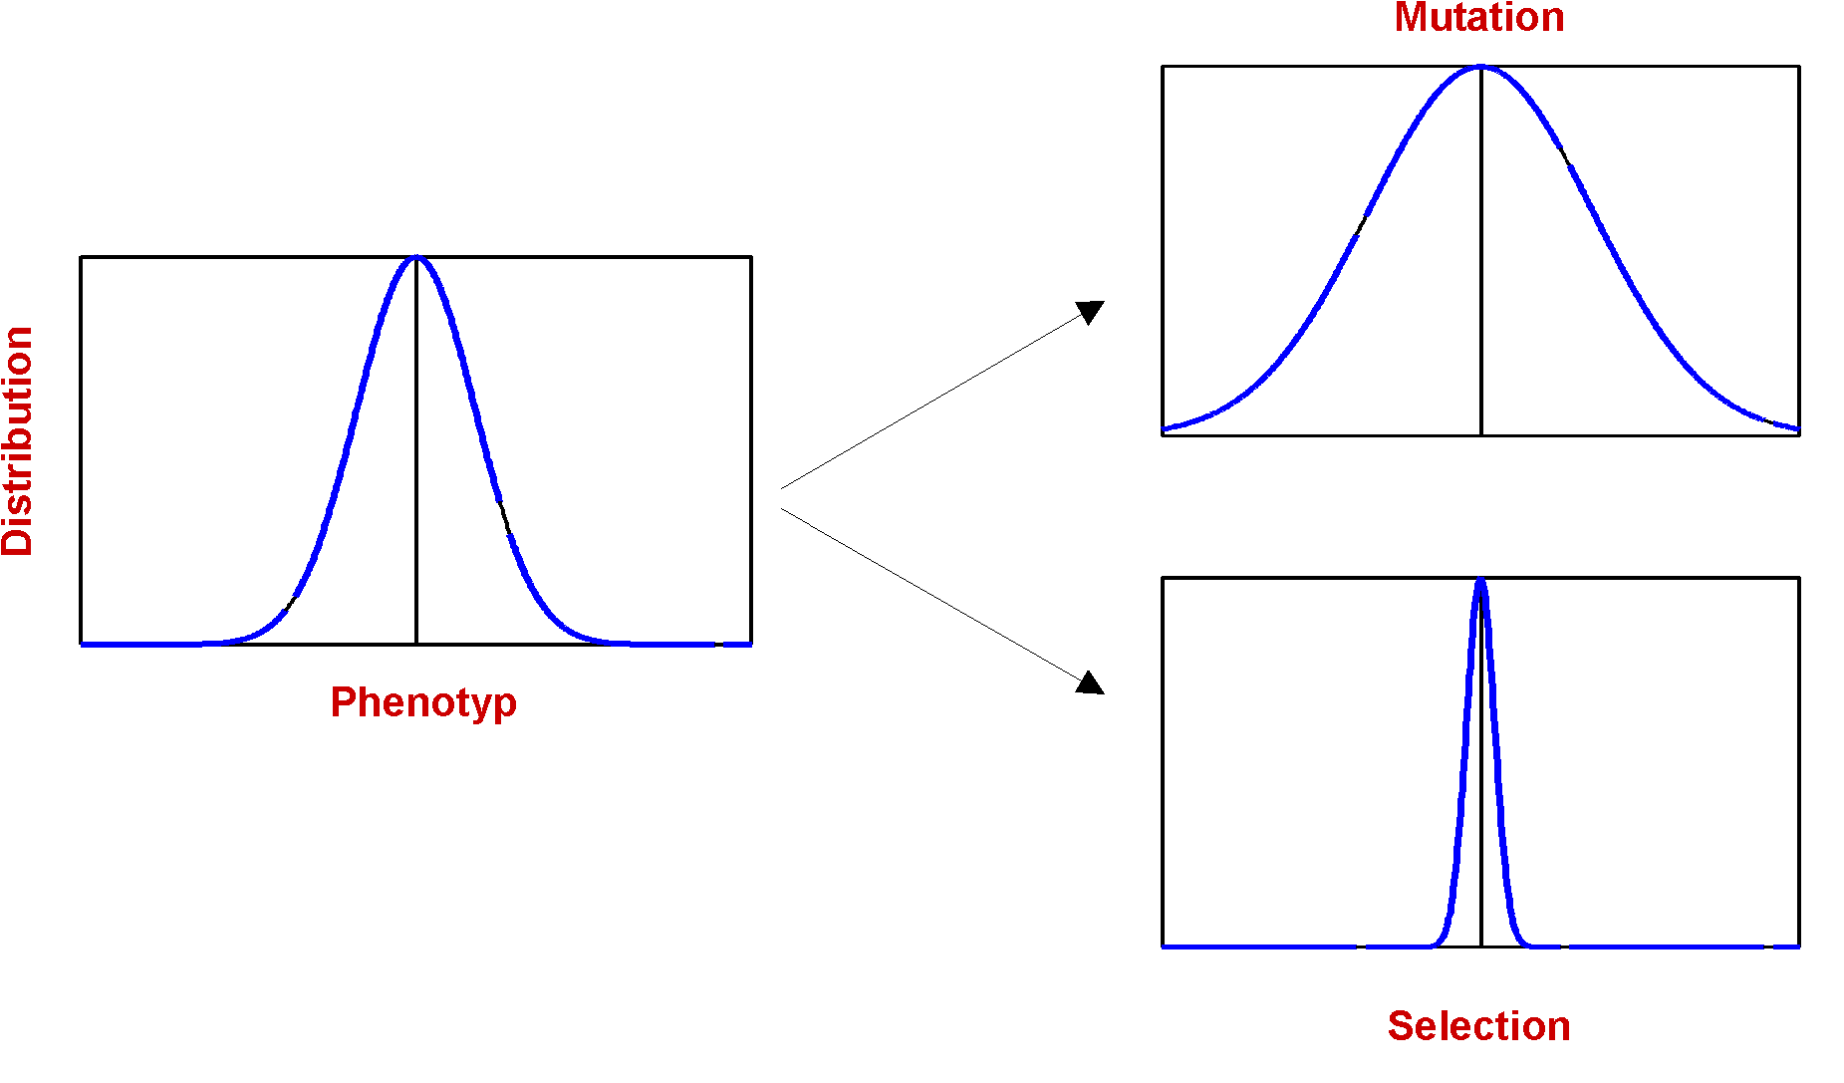
Phenotype Distribution
http://www.ifs.tuwien.ac.at/~aschatt/info/ga/genetic.html

Slide 11
Evaluation and Selection
evaluate fitness of each solution in current
population (e.g., ability to classify/discriminate)
[involves genotype-phenotype decoding]
selection of individuals for survival based on
probabilistic function of fitness
on average mean fitness of individuals increases
may include elitist step to ensure survival of
fittest individual

Slide 12
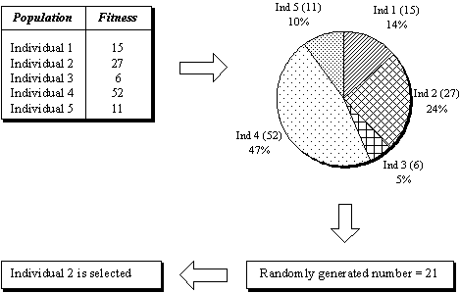
Roulette Wheel Selection
©http://www.softchitech.com/ec_intro_html
Notes:
Mention wheel spin as well as random number generation

Slide 13
Crossover
combine two individuals to create new individuals
for possible inclusion in next generation
main operator for local search (looking close to
existing solutions)
perform each crossover with probability p_{c} {0.5,…,0.8}
crossover points selected at random
individuals not crossed carried over in population

Slide 14
Initial Strings
Offspring
Single-Point
11000101 01011000 01101010
11000101 01011001 01111000
00100100 10111001 01111000
00100100 10111000 01101010
Two-Point
11000101 01011000 01101010
11000101 01111001 01101010
00100100 10111001 01111000
00100100 10011000 01111000
Uniform
11000101 01011000 01101010
01000101 01111000 01111010
00100100 10111001 01111000
10100100 10011001 01101000

Slide 15
Mutation
each component of every individual is modified with
probability p_{m}
main operator for global search (looking at new
areas of the search space)
p_{m} usually small {0.001,…,0.01}
rule of thumb = 1/no. of bits in chromosome
individuals not mutated carried over in population

Slide 16
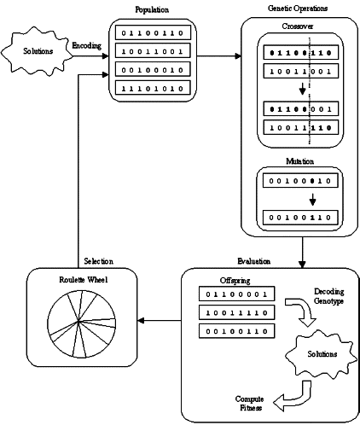
©http://www.softchitech.com/ec_intro_html
Notes:
Repeat cycle for specified number of iterations or until certain fitness value reached

Slide 17
phenotype
genotype
fitness
3021 3058 3240
3017 3059 3165
3036 3185 3120
3197 3088 3106
00010101 00111010 11110000
00010001 00111011 10100101
00100100 10111001 01111000
11000101 01011000 01101010
0.67
0.23
0.45
0.94
3
1
3
4
4
00010101 00111010 11110000
00100100 10111001 01111000
11000101 01011000 01101010
11000101 01011000 01101010
4
2
1
selection
Notes:
Encoding from phenotype to genotype
Avg fitness post-selection is higher

Slide 18
one-point crossover (p=0.6)
0.3
0.8
00010101 00111010 11110000
00100100 10111001 01111000
11000101 01011000 01101010
11000101 01011000 01101010
00010101 00111001 01111000
00100100 10111010 11110000
11000101 01011000 01101010
11000101 01011000 01101010
mutation (p=0.05)
00010101 00111001 01111000
00100100 10111010 11110000
11000101 01011000 01101010
11000101 01011000 01101010
00010101 00110001 01111010
10100110 10111000 11110000
11000101 01111000 01101010
11010101 01011000 00101010
Notes:
Now reevaluate

Slide 19
starting generation
3021 3058 3240
3017 3059 3165
3036 3185 3120
3197 3088 3106
00010101 00111010 11110000
00010001 00111011 10100101
00100100 10111001 01111000
11000101 01011000 01101010
0.67
0.23
0.45
0.94
next generation
00010101 00110001 01111010
10100110 10111000 11110000
11000101 01111000 01101010
11010101 01011000 00101010
3021 3049 3122
3166 3184 3240
3197 3120 3106
3213 3088 3042
0.81
0.77
0.42
0.98
genotype
phenotype
fitness
Notes:
Elitist step unnecessary in this case.
If 0.98 not acceptable, repeat entire process

Slide 20
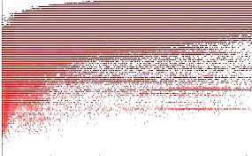
GA Evolution
100
50
Accuracy in Percent
10
0 20 40 60 80 100 120
Generations
http://www.sdsc.edu/skidl/projects/bio-SKIDL/
Notes:
Example of monitoring/diagnostic

Slide 21
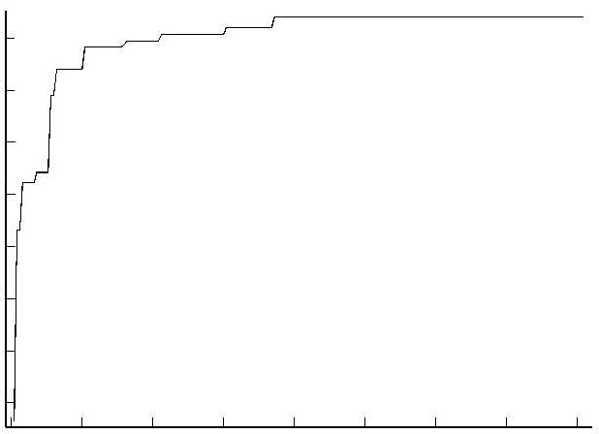
genetic algorithm learning
Fitness criteria
-70 -60 -50 -40
0 50 100 150 200
Generations
http://www.demon.co.uk/apl385/apl96/skom.htm
Notes:
Example of diagnostic (2)

Slide 22
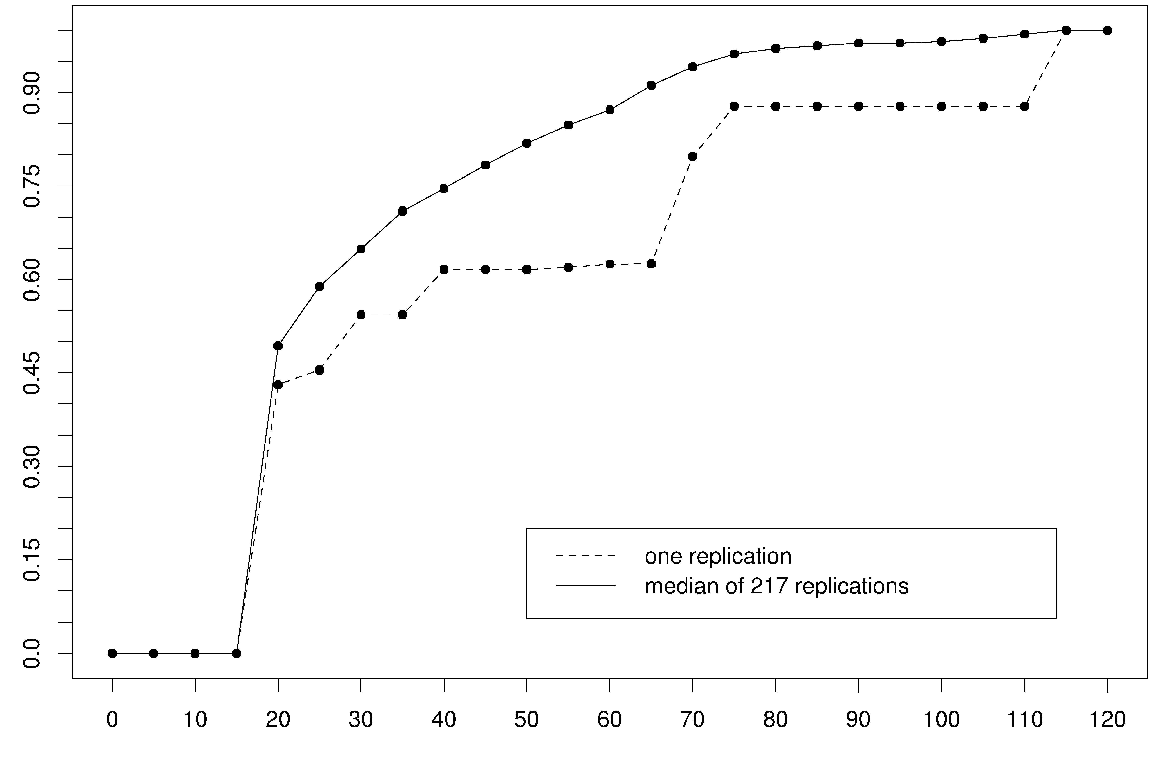
Fitness value (scaled)
iteration
Notes:
GA variability across replications should be noted!

Slide 23
References
Holland, J. (1992), Adaptation in natural and artificial systems , 2nd Ed. Cambridge: MIT Press.
Davis, L. (Ed.) (1991), Handbook of genetic algorithms. New York: Van Nostrand Reinhold.
Goldberg, D. (1989), Genetic algorithms in search, optimization and machine learning. Addison-Wesley.
Fogel, D. (1995), Evolutionary computation: Towards a new philosophy of machine intelligence. Piscataway: IEEE Press.
Bäck, T., Hammel, U., and Schwefel, H. (1997), ‘Evolutionary computation: Comments on the history and the current state’, IEEE Trans. On Evol. Comp. 1, (1)

Slide 24
Online Resources
http://www.spectroscopynow.com
http://www.cs.bris.ac.uk/~colin/evollect1/evollect0/index.htm
IlliGAL (http://www-illigal.ge.uiuc.edu/index.php3)
GAlib (http://lancet.mit.edu/ga/)
Notes:
Colin Burgess/ Univ of Bristol Comp Sci

Slide 25
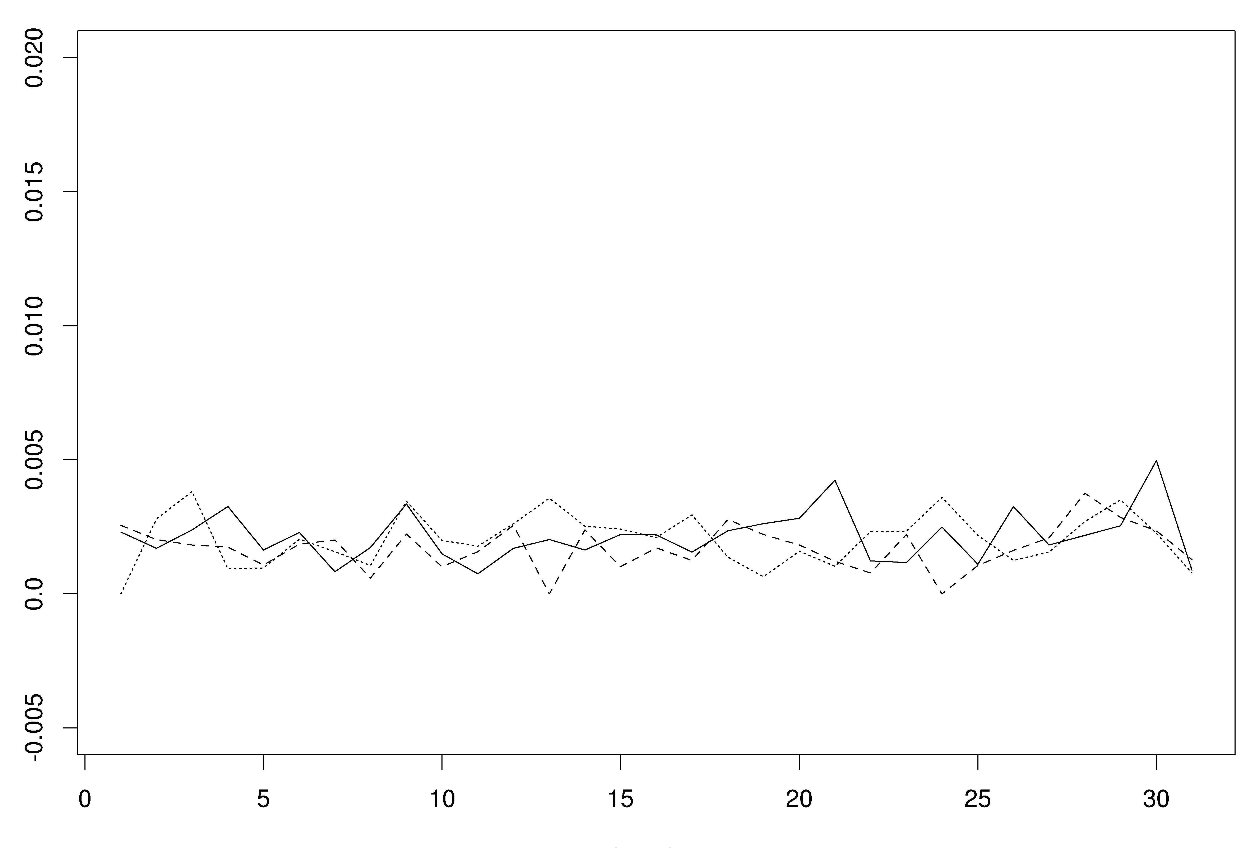
Percent improvement over hillclimber
iteration
Notes:
Do we need a GA?
Performance of replications vs. simple hillclimber …

Slide 26
Schema and GAs
a schema is template representing set of bit strings
1**100*1 { 10010011, 11010001, 10110001, 11110011, … }
every schema s has an estimated average fitness f(s):
E_{t+1} ≥ k ⋅ [f(s)/f(pop)] ⋅ E_{t}
schema s receives exponentially increasing or decreasing
numbers depending upon ratio f(s)/f(pop)
above average schemas tend to spread through
population while below average schema disappear
(simultaneously for all schema – ‘implicit parallelism’)
Notes:
Schemata theorem
E_t = exp num of instances of schema s at time t; K = constant
F(pop) = avg value of strings in pop; formation of schema gives success

Slide 27
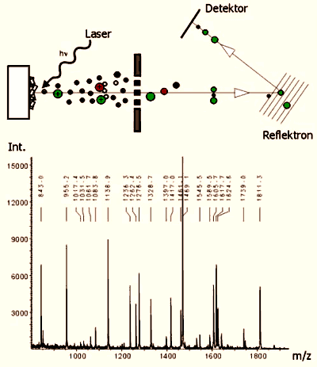
MALDI-TOF
©www.protagen.de/pics/main/maldi2.html

